Slide 1

5G Adoption Simulation
Agent Based Modelling

Slide 2
5G Diffusion Simulation
This model describes the model of 5G diffusion with attempt to answer the question “How does diffusion of 5G technology for people and industries?
The agents are:
People customer
Industries customer
Influencer (can be marketer or solution) from 3 different MNOs
The model measures the Population of 5G adopters versus time

Slide 3
Agent Properties
People Customer & Industries
Have previous MNO selection
Have type of adopter with adoption score Pioneer (2), Early Adopter (4), Medium Adopter (6) Late Adopter (8), Laggards (10
Have colour counts
Influencer
Type of Influencer: People Customers and Industries Customers
Marketer
Influencing customer & Industries
Add 1 to adoption score if meet human or industries
Add 1 to colour counts if meet with humans or industry.

Slide 4
Agent Behaviours
People Customer
Get influenced. Influencing.
Influencer
Get influenced. Influencing.
Industries Customer
Get influenced. Influencing.

Slide 5
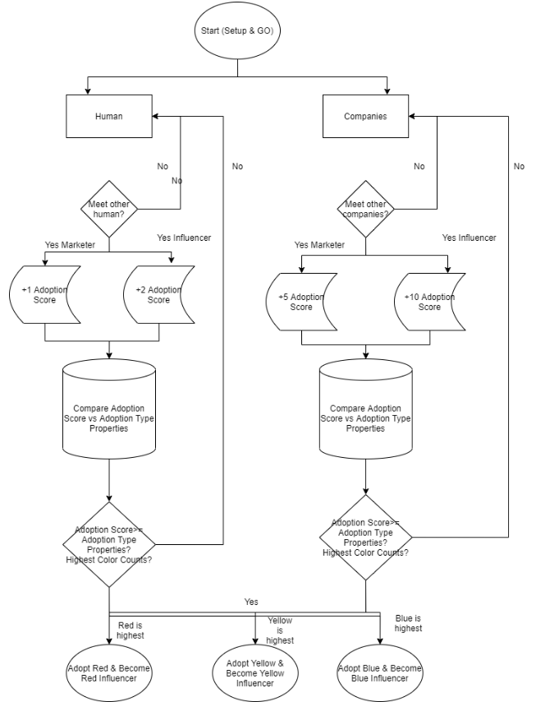
Flowchart

Slide 6
Factors to Decide Adoption (Person)
Buying Power
1-3 mio, 3-5 mio, 5-10 mio, 10 mio
Closeness to the Influencer
Scale 1-5
Adoption Type
Pioneer, Early Adopter, Medium Adopter, Late Adopter, Laggards
Infrastructure Limitation
Needs (Use Case)
Ngikut Teknologi

Slide 7
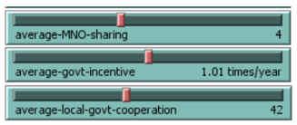
Sliders

Slide 8
All about agents
Who should be the agents in the model?
Human to adopt 5G (after adopting become influencer)
Companies or Industries to adopt 5G (after adopting become influencer)
Marketer
Who are the decision makers in the system?
Human to decide for her/himself
Companies or Industries to decide for themselved
What are the entities that have behaviors?
All agents have the same behaviors:
Get influenced and influencing
Where might the data come from, especially for agent behavior?
Empirical Observation from real world

Slide 9
Agent Data
What data on agents is simply descriptive (static attributes)?
Other than dynamic attributes
What agent attributes are calculated endogenously by the model and updated for the agents (dynamic attributes)?
Coordinates within the world
Adoption Score
Color Counts
What is the agent’s environment? How do agents interact with the environment? Is agent mobility in space important consideration?
Agent mobility in space is not important consideration.

Slide 10
Agent Behaviors
What agent behaviors are of interest?
What decisions do the agents make and what information is required to make such decisions?
What behaviors are being acted upon?
What actions are being taken by the agents?
How would we represent the agent behaviors? By If-then rules? By adaptive probabilities, such as in reinforcement learning? By explicit heuristics? By regression models or neural networks?

Slide 11
Agent Interactions
How do the agents interact with each other?
When they meet
How do the agents interact with the environment?
Not important
How expansive or focused are agent interactions?
Extremely focused

Slide 12
Agent Recap
How we design a set of experiment to explore the importance of uncertain behaviors, data, and parameter?
??? (Butuh ketemuan Mas Ilham, ini apa maksudnya)
How might we validate the model, especially the agent behaviors and the agent interaction mechanisms?
We validate using the common empirical real-life observation which experienced by most of the people.
Supported by grant theories of Adoption Type and brand selection.

Slide 13
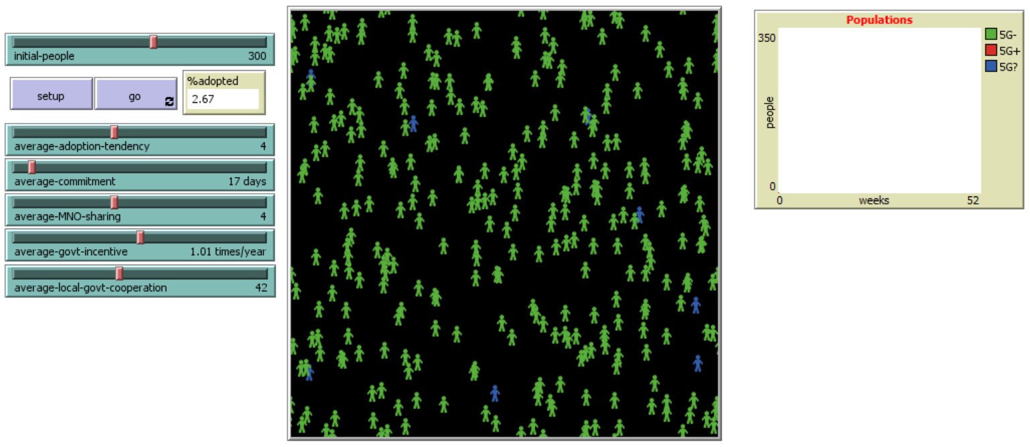

Agents:
(1) People (2) Companies (3-5) Influencer MNO1-3
P
C
Other reports:
(1) Revenue (2) Profit (3) GDP
Rules:
Person adopted 5G if influenced (meet) by 5 other people. The last person influencing will be the determinator of chosen MNO.
Company adopted 5G if influenced (meet) by 5 influencers or 5 other companies. The last influencer or companies influencing will be the determinator of chosen MNO.
MNO Sharing will increase the Influencers numbers up to 20%
Govt Incentive will increase the influencers numbers up to 20%
Local Govt Support will increase the influencer numbers up to 10%, and reduce the number of influencing process by 1

